Slide 1

Bellabeat
PRESENTED BY: SIM CHEE YONG
LAST UPDATED: 2023/06/13

Slide 2
BACKGROUND
Bellabeat is a high-tech manufacturer of health-focused products for women. They have developed smart devices to collect data on activity, sleep, stress, and reproductive health. This has allowed Bellabeat to empower women with knowledge about their own health and habits.
Bellabeat also offers a subscription-based membership program for users. Membership gives users 24/7 access to fully personalized guidance on nutrition, activity, sleep, health and beauty, and mindfulness based on their lifestyle and goals.

Slide 3
DATA PREVIEW
4 types of activity level: sedentary active, lightly active, fairly active, very active.
The sample size were 33 users but some of the data didn’t reach the amount of 33. Thus, we might need more accurate data for further analyse.
The data selected: Daily Intensities, Daily Activity, Daily Sleep, Avg hourly intensities.

Slide 4
OBJECTIVE
Identify the trends and patterns in the smart devices in order to unlock new growth business opportunities.

Slide 5
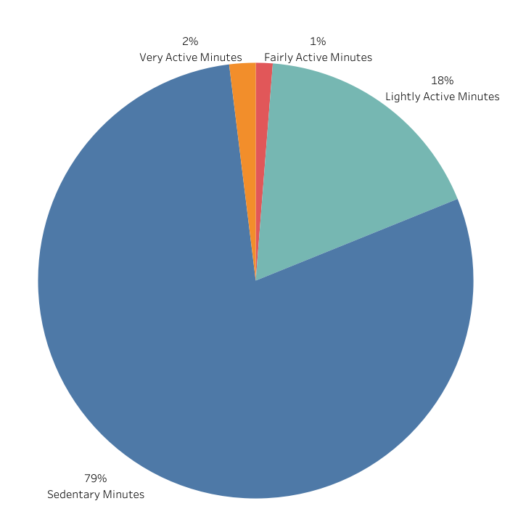
TOTAL ACTIVITY MINUTES SORTED BY ACTIVITY LEVEL
The sedentary minutes included the inactive time awake.
The lightly activity time have spent longer compare with very active and fairly active activity level.

Slide 6
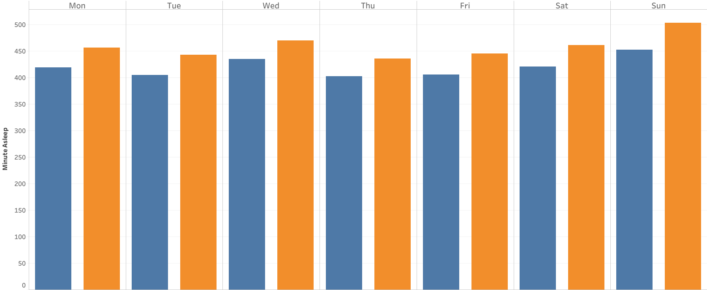
MINUTES ASLEEP VS MINUTES IN BED
The total time in bed were higher than the total time asleep.
The average of total minutes asleep each day is 7 hours and the total minutes on bed is 7.6 hours.

Slide 7
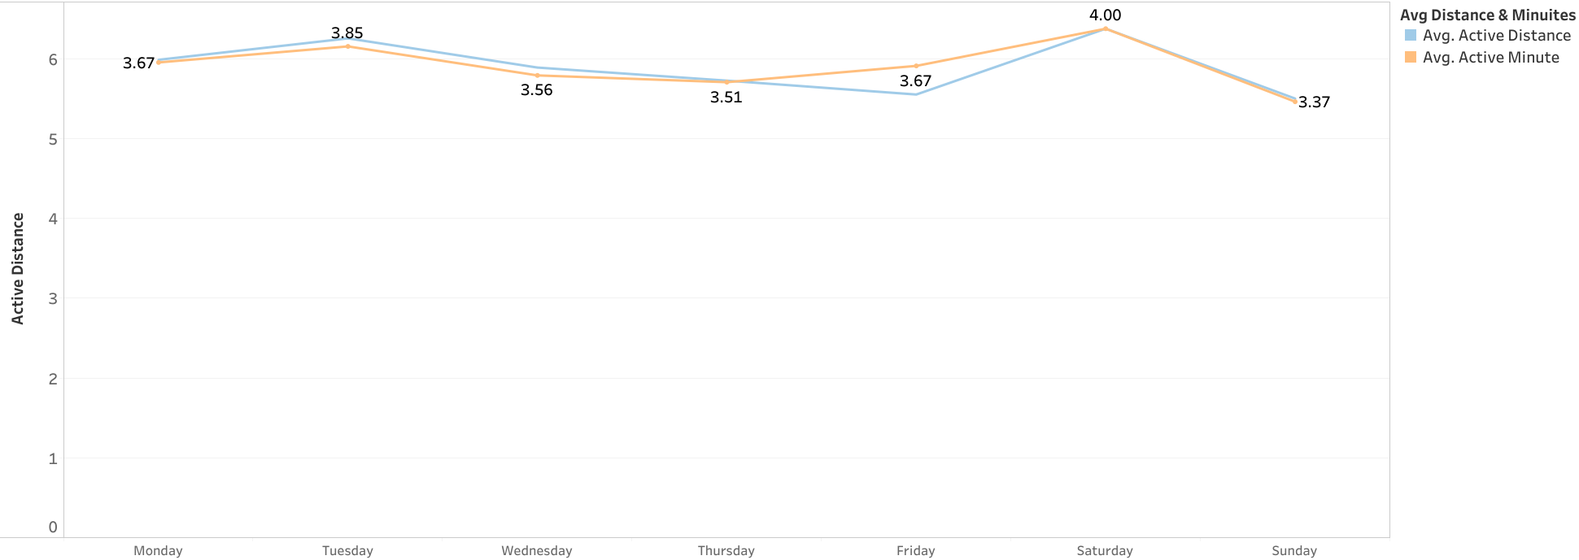
MINUTES AND DISTANCE (KM) SORTED BY DAYS
Tuesday and Saturday have the longest distance but the longest time spent was Saturday (4 hrs).
The average time spent and the distance drop on Sunday.

Slide 8
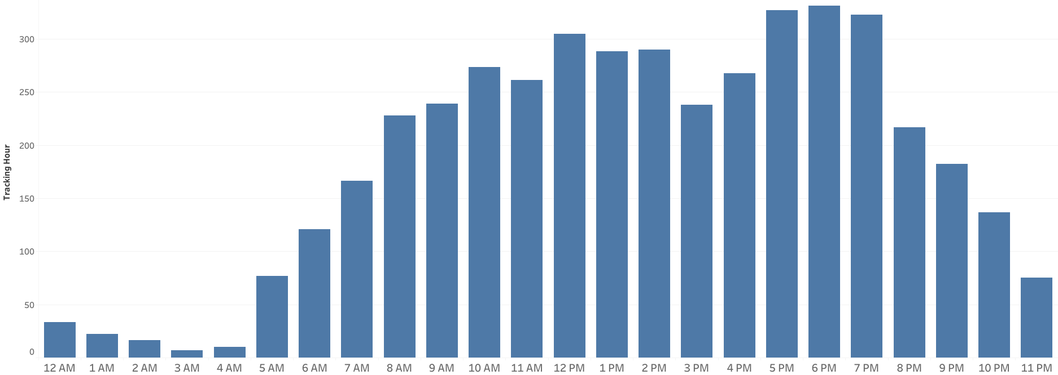
TRACKING ACTIVE HOURS PER DAY
The amount of active hours rise during get off work hour (5pm to 7pm).
Noon have higher active tracking time compare to afternoon.
The active tracking hour start to drop from 8pm.

Slide 9
RECOMMENDATION
Time specific features: Developing a scheduled workout routine or guided mediation sessions that could help our user to wind down after a long day.
Sleep optimization: Develop insight or tools of how to enhance sleep quality in the Bellabeat app features.
Saturday Engagement: Engage users to stay active and healthy. Organize a competition (eg: marathon) during Saturday. Considering collaborate with outdoor activity provider to offer deals for our members during Saturday.

Slide 10
LIMITATION
Insufficient user profile (Like what they do during the off from work period, to determine what caused the highest activity rate during this period.)
Unreliable sample size (There are tracking record were incomplete and some users are not on the record)

Slide 11
THANK YOU

